Slide 1

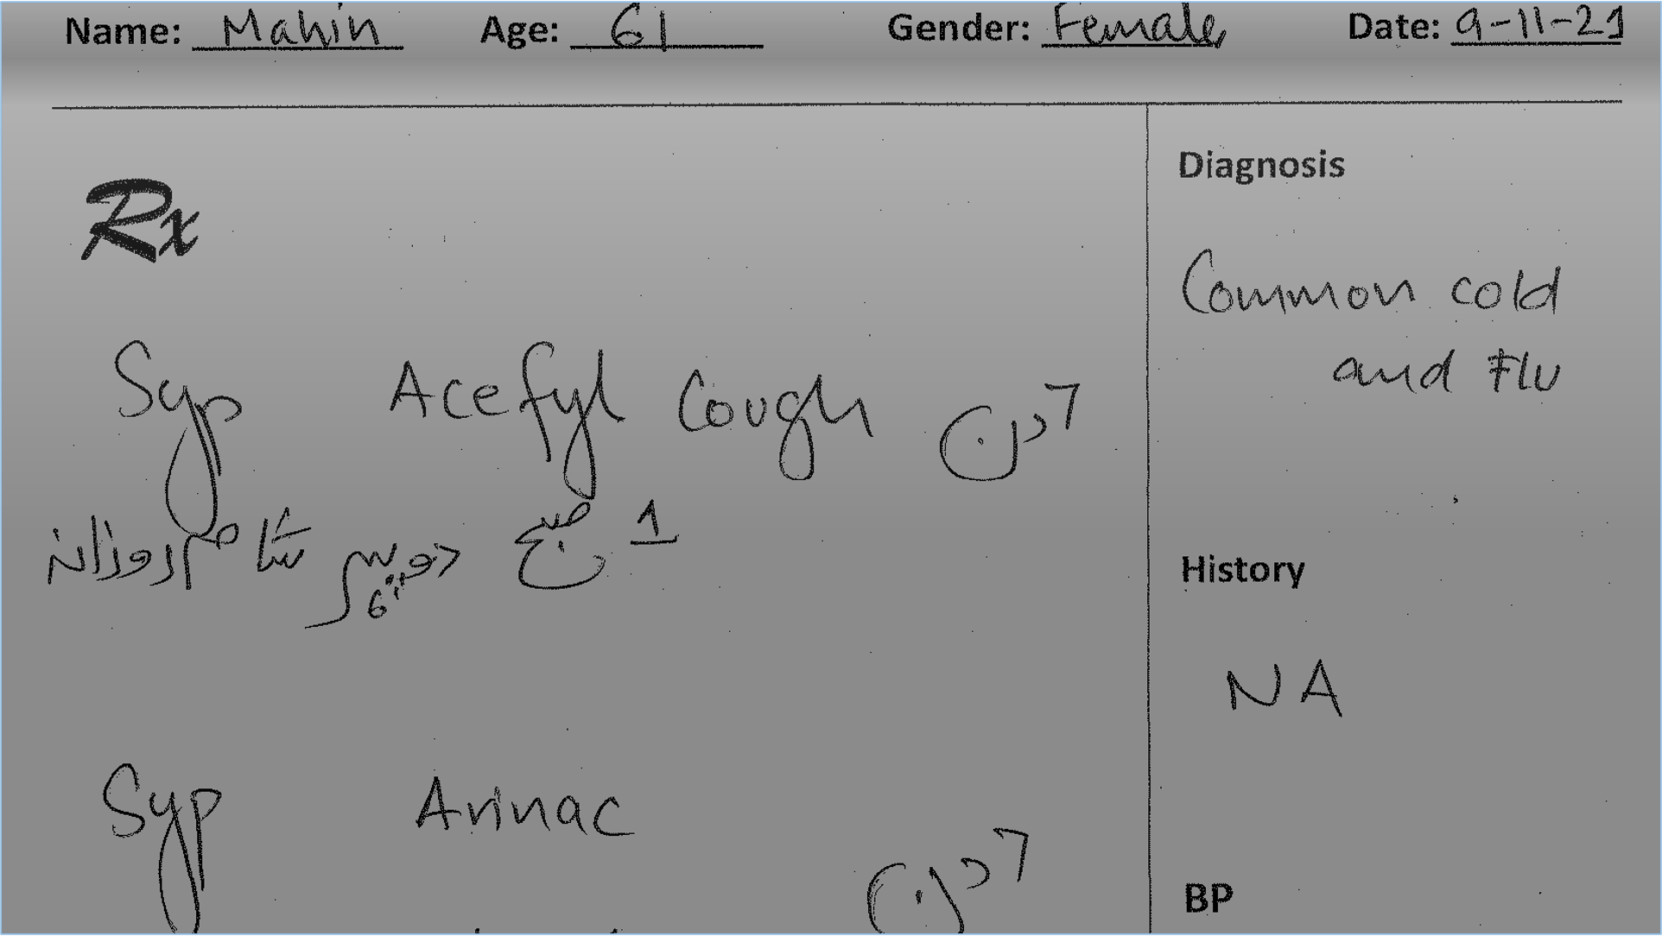

Docigize: Automatic digitization of Handwritten Bilingual Documents
(Handwritten Medical Prescriptions as a case study)
Musa Dildar Ahmed Cheema i191765
Mohammad Daniyal Shaiq i191894
Ali Kamal i191865
Supervisor: Dr. Muhammad Asif Naeem

Slide 2

Introduction
• In Low resourced countries, data is stored and communicated using handwritten documents
• This data gets scraped as storing and analyzing it is a challenge
• There is a need to digitize and structure this information
• These documents, such as medical prescriptions, are usually bilingual – containing both Urdu and English

Slide 3
Importance / Motivation
• Digitizing the data makes it more accessible
• Helps in making data-driven decision making
• Data-driven decisions contribute towards long term sustainability
• Digitizing documents such as Medical Prescriptions helps in improvement of healthcare sector

Slide 4
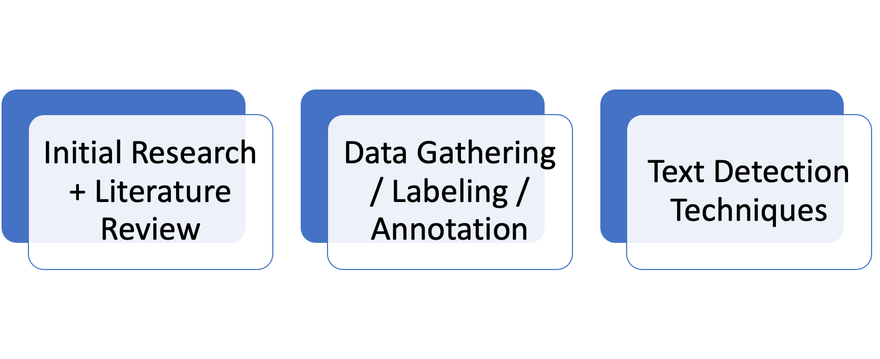
Iteration 1 Commitment

Slide 5

Progress

Slide 6
Initial Research and Literature Review
Title | Methodology | Strengths | Limitations
An attention-based method for offline handwritten Urdu text recognition (ICFHR, 2020)(Anjum and Khan 2020) ¹ | •Encoder Decoder Based •CNN, DenseNet, BLSTM | •Position Change •Attention Mechanism •Relevant Context | •Prediction by text character •Separate model for error correction
A convolutional recursive deep architecture for unconstrained Urdu handwriting recognition (Neural Computing & application, 2021) ² | •Urdu Handwriting •Convolution + BLSTM •Lastly n-gram model | •State of art approaches •Information loss avoid •Image quality | •Separate n-gram model •Lack of longer context •Prone to Error
A Computationally Efficient Pipeline Approach to Full Page Offline Handwritten Text Recognition (ICDARW, 2019) ³ | •Word by word Localization •CNN-BLSTM + Language model | •Line by Line less expensive •Multi-down sampled •Combining BLSTM | •Localize the text word by word •Space issue •Localize only English text
An online cursive handwritten medical words recognition system for busy doctors in developing countries for ensuring efficient healthcare service delivery (Scientific reports, 2022) ⁴ | •Line sequence from image •BLSTM network | •SOTA results •The whole sequence of characters •Taking context in account | •Works only for online handwritten text extraction •Requires doctors to use a smartpen to write.
Multilingual handwritten numeral recognition using a robust deep network joint with transfer learning (Information Sciences (Elsevier),2021) (Fateh, et al. 2021) ⁵ | •Multilingual Handwritten numbers •Deep CNN •Limit to Chinese, Arabic, English, Kannada, Persian, and Urdu •Language recognition and digit recognition •Best model parameters for the recognition of digits | •SOTA Result •Employing Transfer Learning | •Limited to numbers only •Multiple languages can lead to error in text localization •High error rate possible

Slide 7
Initial Research and Literature Review
Title | Methodology | Strengths | Limitations
TrOCR: Transformer-based Optical Character Recognition with Pre-trained Models (Minghao Li, et al. 2021) | •Transformer Architecture •Uses pre-trained CN and NLP models •Splits image into sequence of patches that are used as inputs | •SOTA Results •Uses pre-trained CN and NLP models, which take advantage of large-scale unlabeled data for image understanding and language modeling, with no need for an external language model •Does not require CNN for backbone, so image-specific biases are avoided | •Requires huge amount of data •Not suitable for low-resource languages (e.g Urdu), due to the nature of transformer architecture as it requires large amounts of data
LayoutLM: Pre-training of Text and Layout for Document Image Understanding (ACM, 2019)(Yiheng Xu, et al. 2019) | •Uses both text and document layouts for training •Joint training in textual and layout information •BERT is used as the backbone, and adds two new input embeddings: Positional and image embedding •Positional embeddings to capture relationship among tokens within a document | •SOTA Results •Takes into account both textual and layout information, which is beneficial for a great number of real-world document image understanding tasks such as information extraction from scanned documents | •Only works for English (will not work for Urdu, or multilingual use cases) •Needs a separate model for text extraction and localization, alongside the LayoutLM model itself, which is quite computationally heavy

Slide 8
Research Similarity
Title | Similarity
An attention-based method for offline handwritten Urdu text recognition (ICFHR, 2020)(Anjum and Khan 2020) ¹ | • Urdu Language extraction, as well as we intend to localize language • This paper can act as our baseline for Urdu text extraction
A convolutional recursive deep architecture for unconstrained Urdu handwriting recognition (Neural Computing & application, 2021) ² | • Urdu handwritten text extraction • FYP is about extracting bilingual text (Urdu and English) • Paper deals with the Urdu extraction part, which is a module in the Document text extraction.
A Computationally Efficient Pipeline Approach to Full Page Offline Handwritten Text Recognition (ICDARW, 2019) ³ | • We intend to extract text from a free form (full page) bilingual document (English and Urdu) • We also intend to work on a modular approach as proposed by this research paper
An online cursive handwritten medical words recognition system for busy doctors in developing countries for ensuring efficient healthcare service delivery (Scientific reports, 2022) ⁴ | • They work with handwritten, bilingual handwriting, which is precisely similar to our use case • Work in a similar demographic to ours, i-e, the authors use a developing country like Bangladesh for their case study
Multilingual handwritten numeral recognition using a robust deep network joint with transfer learning (Information Sciences (Elsevier),2021) (Fateh, et al. 2021) ⁵ | • Very similar to what we intend to do, with both a multilingual approach, as well as considering Urdu in their problem as well, but limited to digits
TrOCR: Transformer-based Optical Character Recognition with Pre-trained Models (Minghao Li, et al. 2021) | • This is essentially the application of TrOCR, but we intend to work on the handwritten text for both English and Urdu
LayoutLM: Pre-training of Text and Layout for Document Image Understanding (ACM, 2019)(Yiheng Xu, et al. 2019) | • Our research work also deals with entity extraction based on layout information, so there’s a relation of this work in our research.

Slide 9
GAP
• No work has been done for mainstream work on multilingual free-form document digitization
• No work has been done, especially for Urdu Documents
• Some work has been done for the multilingual document, but they don’t cater to English and Urdu Language.

Slide 10

PROBLEM STATEMENT
To the best of our knowledge, there does not exist any robust method to digitize bilingual handwritten free form documents particularly in English and Urdu

Slide 11
In this R&D-based project, we aim to build a system that can extract bilingual handwritten text with different scripts Roman script for English and Nastaliq script for Urdu
Proposed Solution

Slide 12
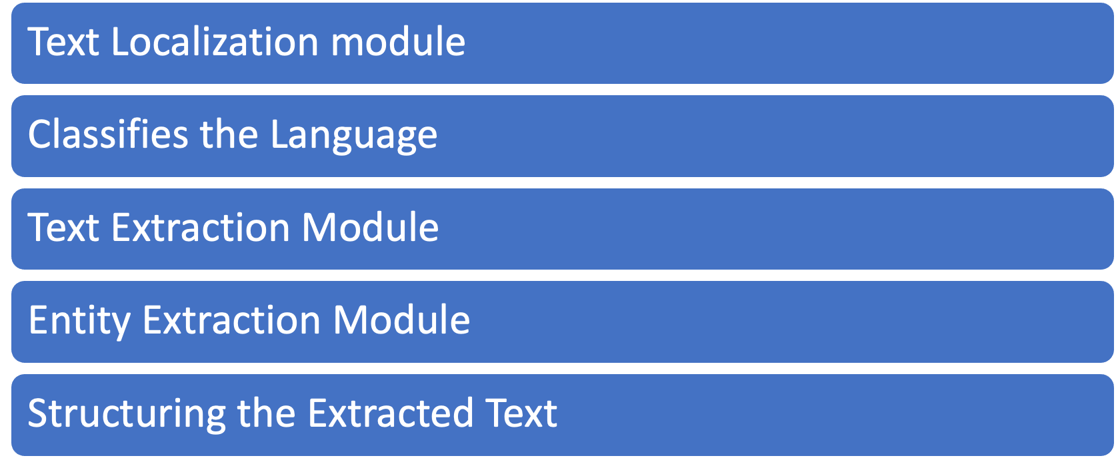
Proposed Methodology

Slide 13
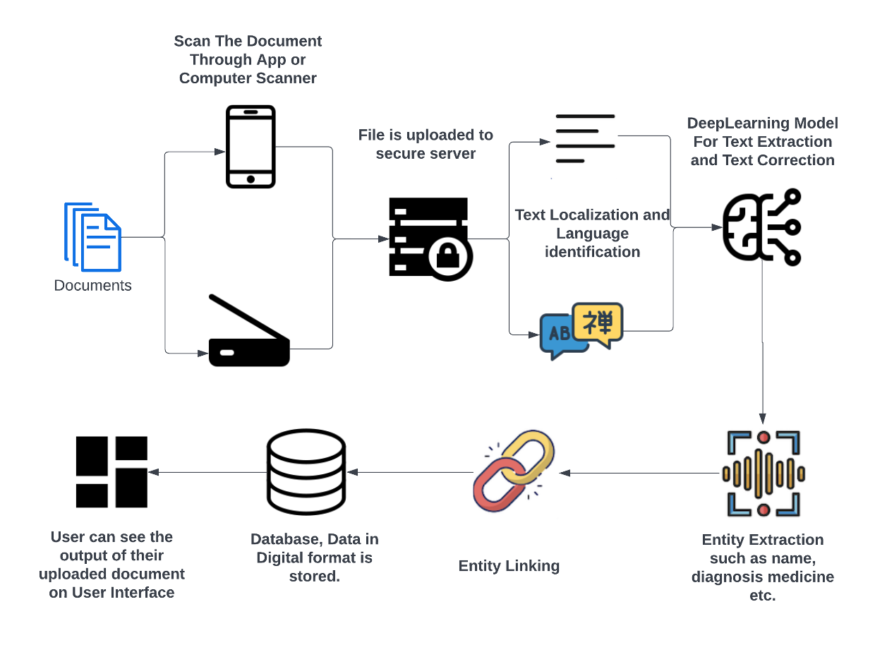
Architecture

Slide 14

Work Progress

Slide 15
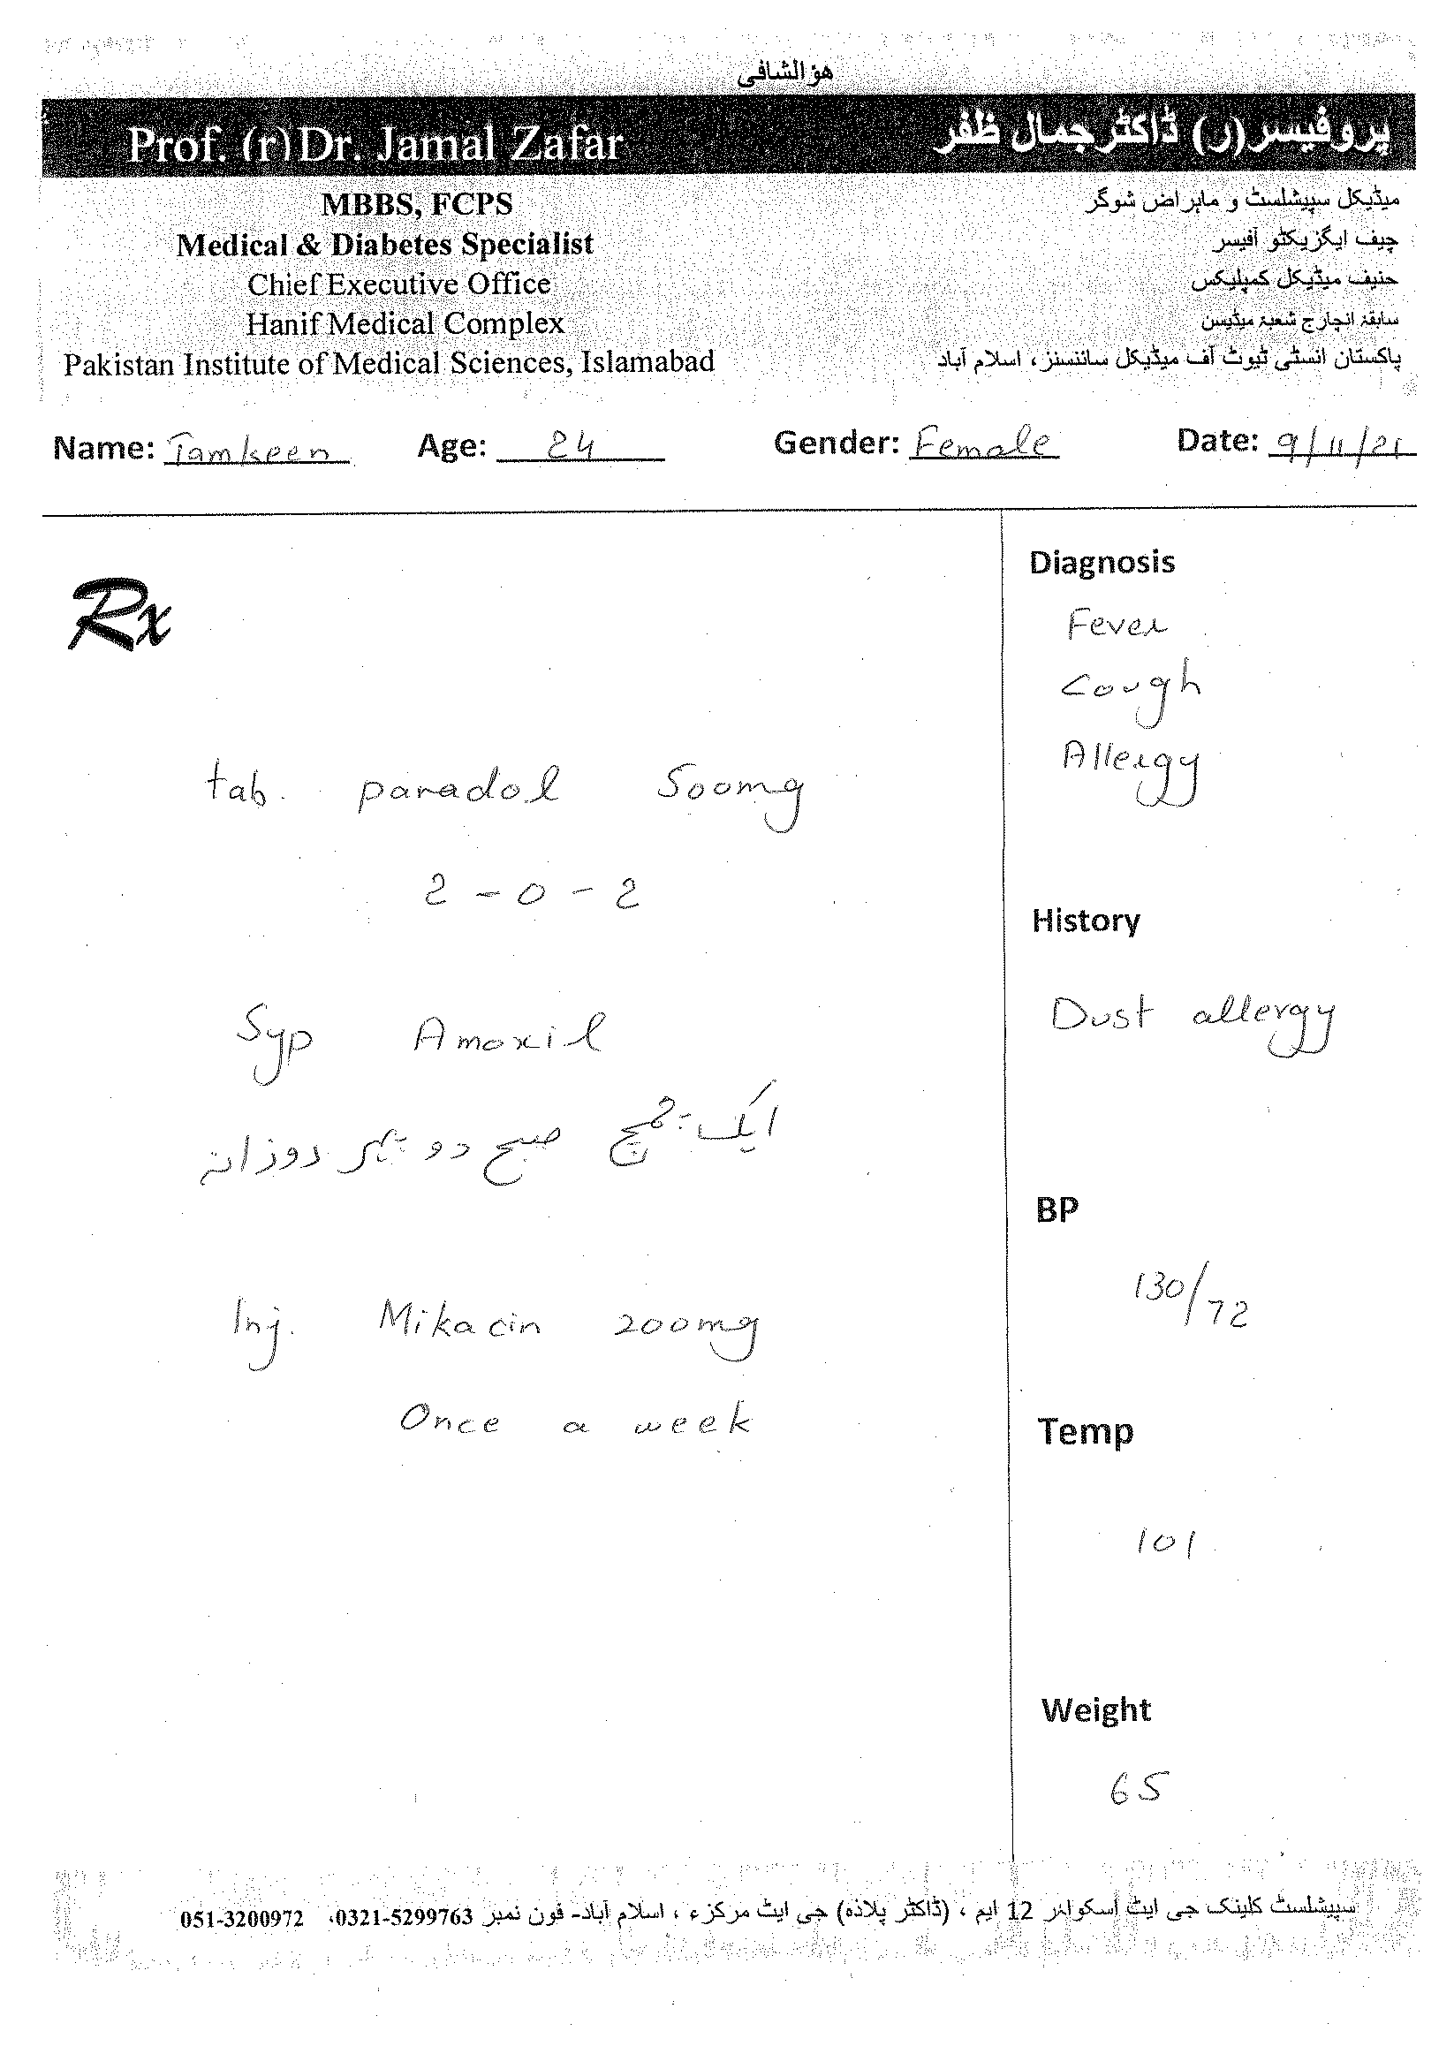
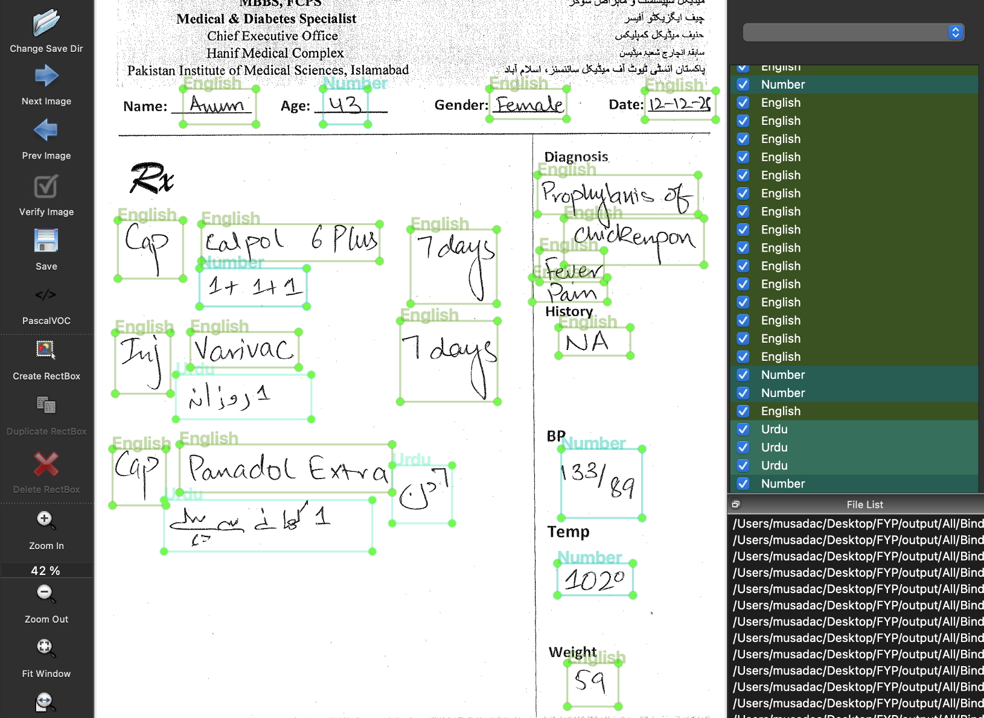
Data Gathered
Data Annotation

Slide 16
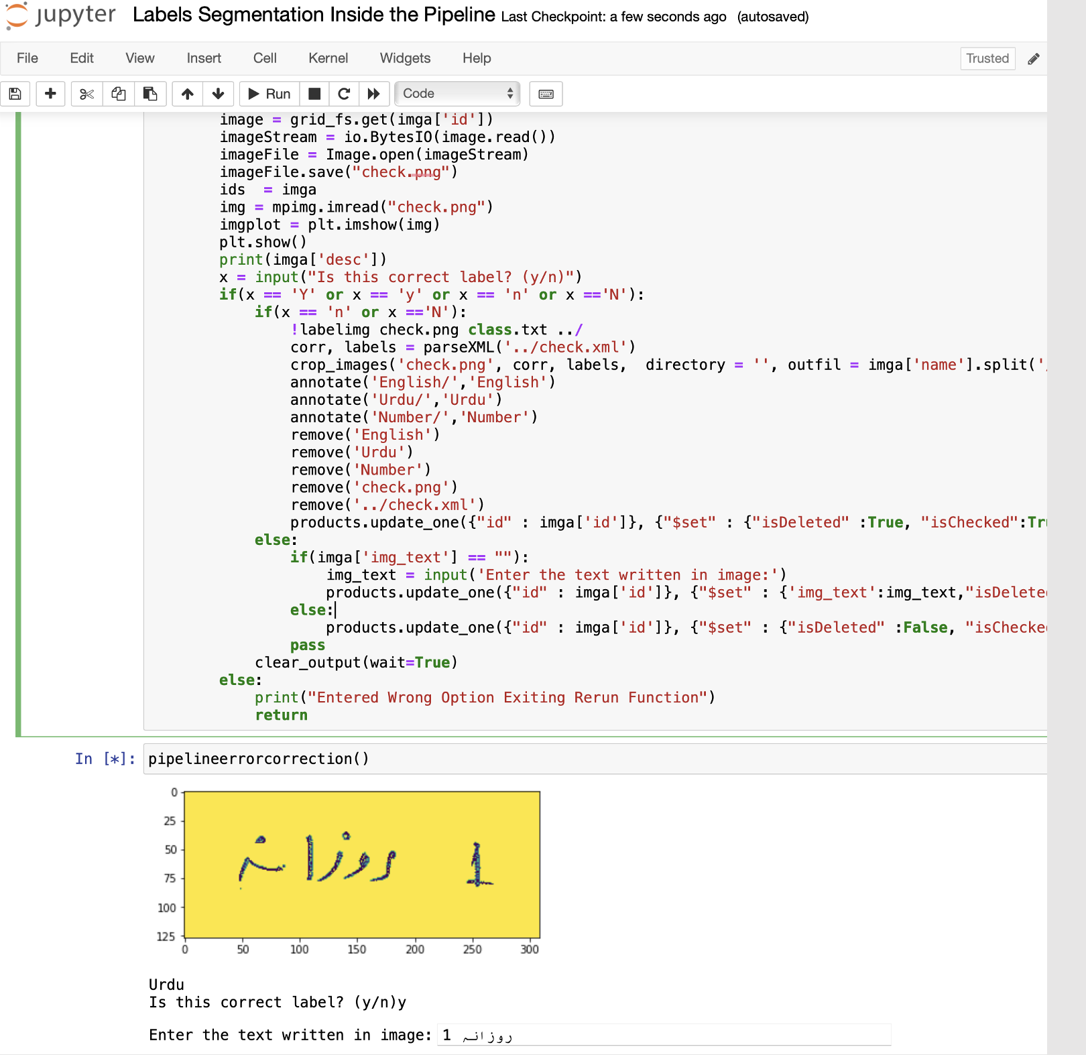
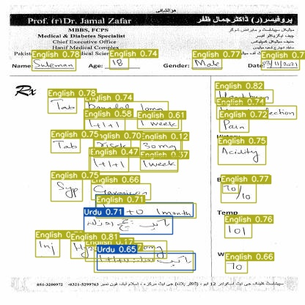
Data Labeling
Language Detection

Slide 17

Language Detection Models
YOLO v3
Class | Images | Labels | Precision | Recall
all | 72 | 1557 | 0.857 | 0.811
English | 72 | 1501 | 0.873 | 0.854
Urdu | 72 | 56 | 0.84 | 0.768
YOLO v4
Class | Images | Labels | Precision | Recall
all | 72 | 1557 | 0.851 | 0.804
English | 72 | 1501 | 0.883 | 0.864
Urdu | 72 | 56 | 0.82 | 0.745

Slide 18

YOLO v5
Class | Images | Labels | Precision | Recall
all | 72 | 1557 | 0.837 | 0.8135
English | 72 | 1501 | 0.884 | 0.855
Urdu | 72 | 56 | 0.79 | 0.772
YOLO v7
Class | Images | Labels | Precision | Recall
all | 72 | 1557 | 0.836 | 0.777
English | 72 | 1501 | 0.893 | 0.869
Urdu | 72 | 56 | 0.779 | 0.799

Slide 19

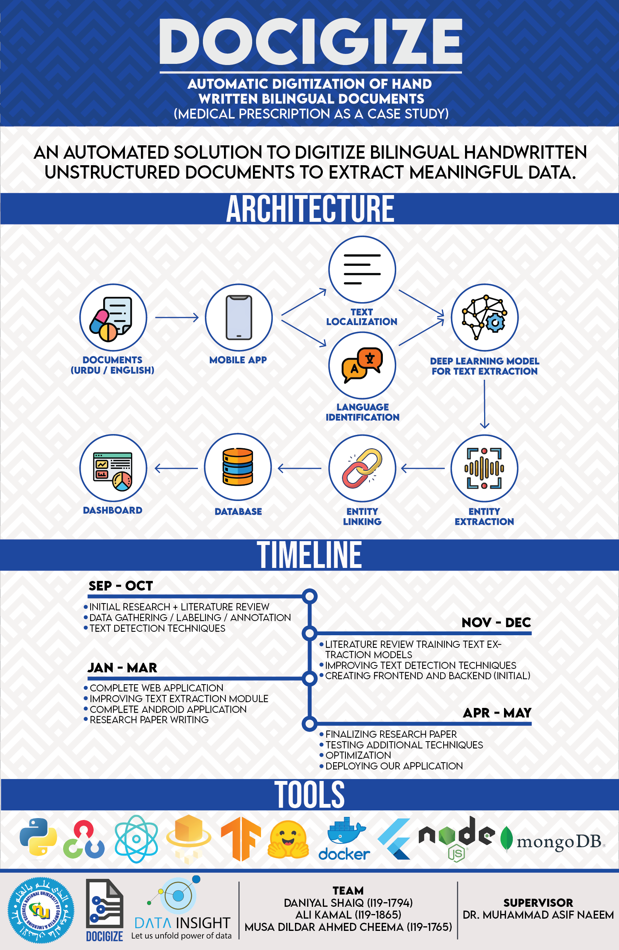
POSTER

Slide 20
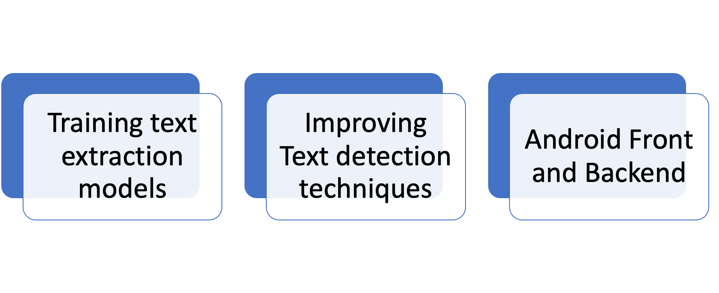
Plan for Iteration 2

Slide 21
Your Comments

Slide 22

Thank You

